Slide 1
__ __ __ __ ____ U|' \/ '|u\ \ /"/uU /"___| \| |\/| |/ \ \ / // \| | u | | | | /\ V /_,-.| |/__ |_| |_| U \_/-(_/ \____| <<,-,,-. // _// \\ (./ \.) (__) (__)(__) _____ ____ _ __ __ U _____ u U ___ u ____ _ __ ____ |" ___|U | _"\ u U /"\ uU|' \/ '|u\| ___"|/__ __ \/"_ \/U | _"\ u |"|/ / / __"| u U| |_ u \| |_) |/ \/ _ \/ \| |\/| |/ | _|" \"\ /"/ | | | | \| |_) |/ | ' / <\___ \/ \| _|/ | _ < / ___ \ | | | | | |___ /\ \ /\ / /\.-,_| |_| | | _ < U/| . \\u u___) | |_| |_| \_\ /_/ \_\ |_| |_| |_____|U \ V V / U\_)-\___/ |_| \_\ |_|\_\ |____/>> )(\\,- // \\_ \\ >><<,-,,-. << >>.-,_\ /\ /_,-. \\ // \\_,-,>> \\,-.)( (__) (__)(_/ (__) (__)(__) (__)(./ \.) (__) (__)\_)-' '-(_/ (__) (__) (__)\.) (_/(__)

Slide 2
MVC Overview
A software architectural pattern for implementing user interfaces
Divides a given software application into three interconnected parts that provide abstraction

Slide 3
History
Introduced by Trygve Reenskaug in the 1970s
Integrated into Smalltalk-76
Expressed as a general concept for the first time in 1988 in an article in The Journal of Object Technology

Slide 4
Three Components
Model
Consists of application data, business rules, logic and functions
View
Can be any output representation of information, such as a chart or a diagram
Multiple views of the same information are possible
Controller
Accepts input and converts it to commands for the model or view

Slide 5
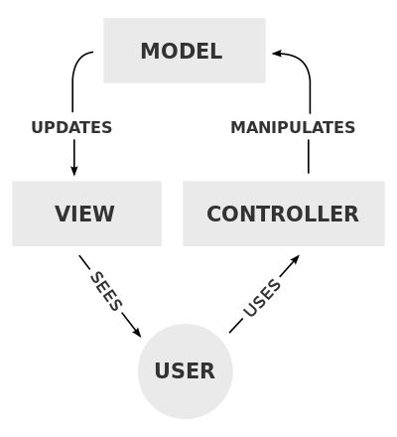

Slide 6
Model
Notifies its associated view and controlls when there has been a change in its state
Notification allows the view to produce updated output, and the controllers to change the available set of commands
Can also be passive and components must poll the model for updates
This is the backend database that stores the object information

Slide 7
View
Requests information from the model that it needs for generating an output representation to the user
This is the UI, what the user sees and interacts with

Slide 8
Controller
Sends commands to the model to update its state
It can also send commands to its associated view to change the view’s presentation of the model
This is the business logic that controls everything
The meat of the application

Slide 9
Videos!
https://www.youtube.com/watch?v=LiBdzE_DJn4
https://www.youtube.com/watch?v=eTdVkgF_Slo
[0-4:17] https://www.youtube.com/watch?v=Iwwznm9XSME
[10:10-21:50] https://www.youtube.com/watch?v=AAcc_uZ3fdU

